Slide 1
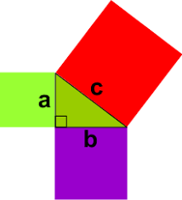
Pythagoras Theorem Part 2
Year 9
Week 6
Lesson 4

Slide 2

Lesson Objectives
Be able to label a right angle triangle
Be able to use Pythagoras to find the hypotenuse
Be able to find the shorter side using Pythagoras Theorem

Slide 3
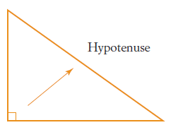
24
7
30
Topic: Pythagoras Theorem
Date
EQ – What is Pythagoras Theorem and how do we use it?
A right-angled triangle has one angle measuring 90° and two smaller angles. The side opposite the right angle is the longest side.
That is called the hypotenuse.
What is the hypotenuse?

Slide 4
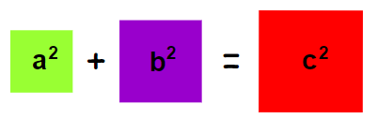
24
7
30
Topic: Pythagoras Theorem
Date
EQ – What is Pythagoras Theorem and how do we use it?
What is Pythagoras Theorem?
For any right-angled triangle, the square of the hypotenuse is equal to the sum of the squares of the other two sides.

Slide 5
A plane flies 120km due north, and then heads due east for 80km. How far is the plane from it’s starting point?
How do we calculate the final distance?
80km
120km

Slide 6
24
7
30
Topic: Pythagoras Theorem
Date
EQ – How do we use Pythagoras to find the length of the shorter sides
We can also use Pythagoras’ theorem to find the length of a shorter
a² = c² – b²
Square the longer side
Subtract the square of the other known side
Square root your answer to get the unknown shorter side
How do you find the length of the Shorter Side?

Slide 7
Example
a² = c² - b²
a² = 13² - 12²
a² = 169 - 144
a² = 25
a = √25
a = 5 cm
13cm
12cm
a

Slide 8
Example
b² = a² - c²
b² = 14² - 6²
b² = 196 - 36
b² = 160
b = √160
b = 12.65 cm
6cm
b
14cm

Slide 9
Task
Complete worksheet

